Slide 1
Java Programming
Write once, run anywhere

Slide 2
Content of the Day
Module2 : Object-Oriented Programming (OOP) | 0- Recap of Java Basics 1- Object-Oriented Programming (OOP) Concepts 2- Constructors and Initialization 3- Access Modifiers and Encapsulation 4- Abstraction and Interfaces 5- Inheritance and Polymorphism

Slide 3
02
Object-Oriented Programming (OOP):
Building Robust and Scalable Solutions with OOP Concepts

Slide 4
Java OOP
What is Programming Paradigms
What is Object-Oriented Programming (OOP)?
Key Features and Benefits of OOP
Remember Mario example ?

Slide 5
Class vs. Object
Class :
Definition: A blueprint or template that defines the structure and behavior of an object.
Example: A recipe for making a delicious cake, specifying its ingredients and steps.
Object :
Definition: A specific instance created from a class, representing a unique entity with its data and actions.
Example: An actual cake made using the recipe, distinct in flavor, size, and appearance.

Slide 6
Task 1
Instructions:
Define a class representing a simple object (e.g., "Car") with attributes (e.g., "make," "model," "year") and methods (e.g., "start," "stop," "accelerate").
Create multiple objects of the class, setting different attribute values for each object.
Implement methods to perform actions on the objects (e.g., start the car, stop the car, accelerate).

Slide 7
Java OOP
The Four Pillars of OOP:
Encapsulation
Inheritance
Polymorphism
Abstraction

Slide 8
Java OOP
Encapsulation:
Definition and Purpose
Access Modifiers (public, private,default, protected)
Getters and Setters for Data Hiding

Slide 9
Access modifiers
Private
Default
Public
When a class member (method, variable, or inner class) is declared as private, it can only be accessed within the same class where it is defined.
A class member with default access (no modifier) is accessible only within the same package where it is defined. Members with default access are not accessible by classes outside the package
When a class member is declared as public, it is accessible from any part of the codebase, including other classes, packages, and subclasses.

Slide 10
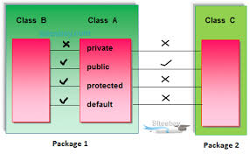
Access Modifiers

Slide 11
Non Access Modifiers
Abstract
Final
Static
An abstract class cannot be instantiated directly; it serves as a blueprint for its subclasses. Abstract classes can have abstract methods (methods without implementation) that must be implemented by its concrete subclasses.
When applied to variables or methods, final indicates that the variable's value cannot be changed, or method can't be override.
When used with classes, final prevents the class from being subclassed.
When a variable or method is declared as static, it means that the variable is shared across all instances of the class, and the method can be called without creating an instance of the class.

Slide 12
Encapsulation:
Encapsulation:
Why Use Getters and Setters?
Encapsulation: Controlling Access to Data Validation:
Ensuring Data Integrity : Controlled Access to Data

Slide 13
Task2:
Instructions:
Create a Java class representing a simple entity (e.g., "Student," "Employee," or "Product").
Define private attributes (fields) for the class (e.g., name, age, salary).
Implement public getter methods for each private attribute to retrieve their values. Implement public setter methods for each private attribute to set their values.
Add validation checks in the setter methods (e.g., age should be positive) to ensure data integrity.
Create an instance of the class and demonstrate the use of getter and setter methods to access and modify the attributes

Slide 14
Java OOP
Inheritance:
Extending Classes and Subclasses
Reusability and Code Organization
Superclasses and Subclass Constructors

Slide 15
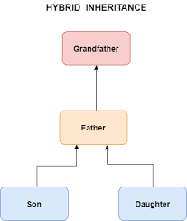
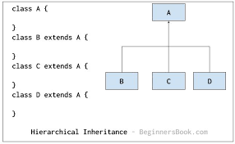
Inheritance

Slide 16
Task3:
Instructions:
Create a base class (e.g., "Animal") with common attributes and methods shared by multiple subclasses.
Create two or more subclasses (e.g., "Dog," "Cat") that inherit from the base class.
Add additional attributes and methods specific to each subclass (e.g., "bark" for "Dog" and "meow" for "Cat").
Instantiate objects of both the base class and subclasses and demonstrate method overriding (e.g., "makeSound") for each.

Slide 17
Java OOP
Polymorphism:
Method Overriding
Method Overloading
Achieving Runtime Polymorphism

Slide 18

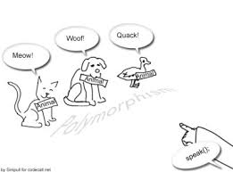
Polymorphism

Slide 19
Java OOP
Abstraction:
Abstract Classes and Methods
Interfaces and Implementation
Benefits of Abstraction

Slide 20
Task4
Instructions:
Create an abstract class (e.g., "Shape") with abstract methods (e.g., "calculateArea") and concrete methods (e.g., "displayInfo").
Implement two or more concrete subclasses (e.g., "Rectangle," "Circle") that extend the abstract class and provide specific implementations for abstract methods.
Create an interface (e.g., "Drawable") with a method (e.g., "draw") for classes that can be drawn.
Have one or more subclasses implement the "Drawable" interface and demonstrate how it enhances flexibility by allowing different classes to have the "draw" capability.

Slide 21
—Someone Famous
"Object-Oriented Programming (OOP) empowers us to mold the chaos of code into structured, reusable building blocks, unlocking the true potential of software design."

Slide 22
Thanks!
Do you have any questions?
amerosama.jr@gmail.com
01007698027

